Slide 1
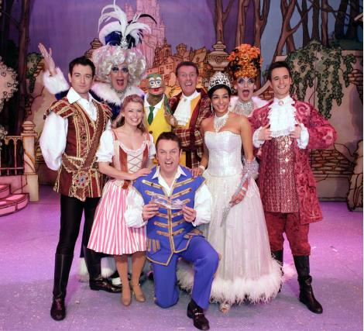
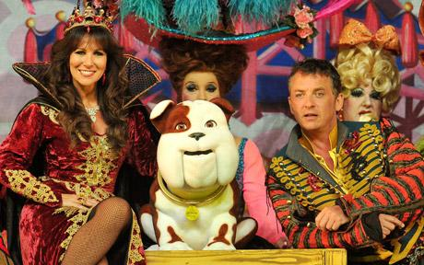
PANTOMIME
Yr 7 Drama
Lesson 4
Audience Participation

Slide 2
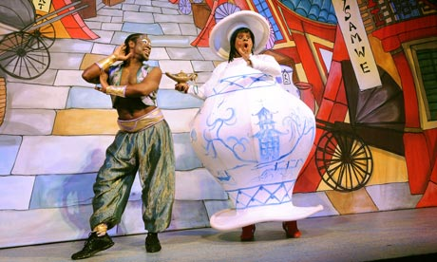
RANDOM REGISTER
In true Pantomime style let’s answer the register with an unusually large and exaggerated performance.
When I say is ……..here?
You must say “Oh Yes he is” or “Oh No she isn’t”

Slide 3
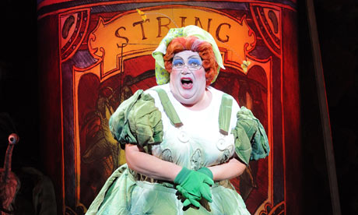
LESSON OBJECTIVE
To investigate audience participation within a pantomime

Slide 4
Level | Drama Strand
 | Creating | Performing | Reflecting
Entry | I can take part in a drama activity | I can participate in part of a group performance | I can identify positive and negative aspects within my work
1 | I can take part in a range of drama activities I can explore problems in an imagined world and make up plays from stories or other stimuli | I can participate in a short group performance I show some consideration of movement and voice in performance | I can make simple connections between the dramas I experience and my own life I can recognise when my own work and the work of others’, could be improved
2 | I can perform my own simple scenes, demonstrating an understanding of drama techniques | I can use my voice and body to create a simple character I can act out improvised dramas | I can talk about why I made certain decisions in my play I can show a basic understanding of how meaning can be shown
3 | I can establish a character with control over movement and voice I can use the dialogue in existing texts as well as creating my own I can devise plays from a range of stimuli I can respond to the use of drama techniques to deepen the role or understanding of the situation e.g. hot seating I can sustain a defined character for a reasonable amount of time | I can learn lines and organise simple performances | I can give suggestions on how work could be improved I can talk about my work using some technical drama terminology I can discuss and give reasons for my preferences in the drama I have seen

Slide 5
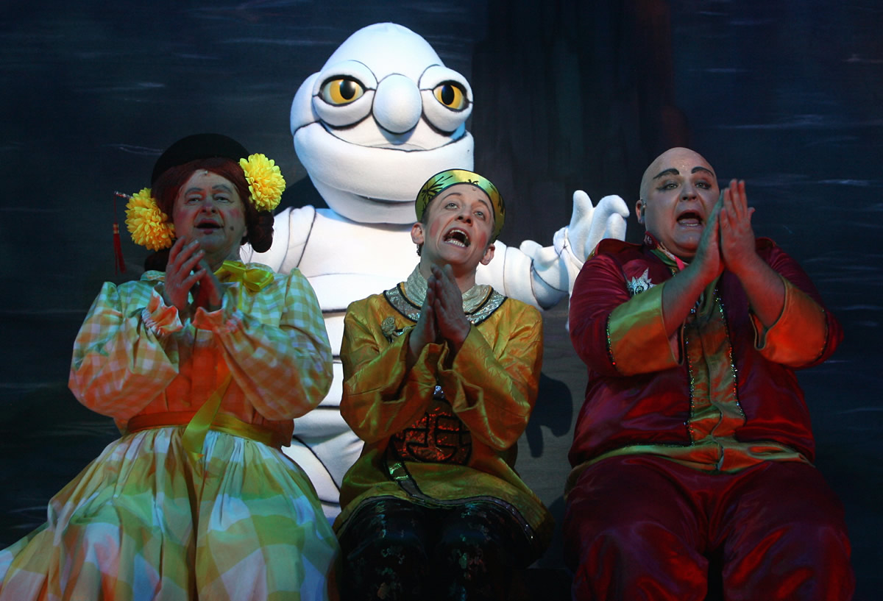
THE GHOST GAG
Lesson Objective:
To investigate audience participation within a pantomime
To understand how to include an audience in a pantomime performance.
TODAY WE ARE GOING TO LEARN THE GHOST GAG!
FIRST WE NEED TO FIND OUT WHO FEELS CONFIDENT!

Slide 6
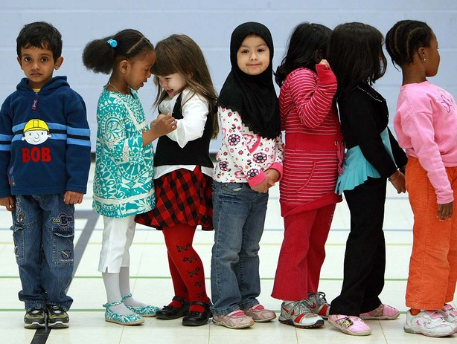
LINE UP
Lesson Objective:
To investigate audience participation within a pantomime
To understand how to include an audience in a pantomime performance.
Students must form a straight line.
Students who have think they can play a main part must go to one end of the line.
Students who want a middle part must go to the middle of the line.
Students who want a smaller part must go to the other end of the line.

Slide 7
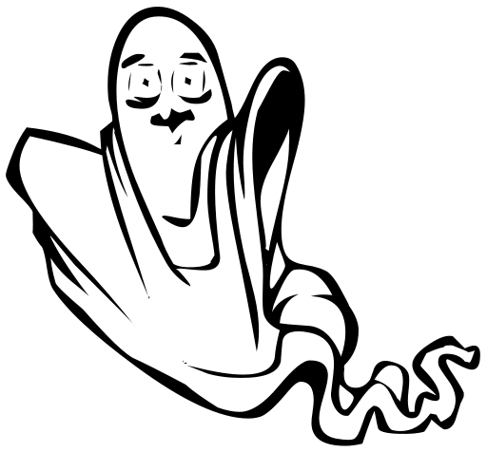
TEACHER GROUPINGS
Lesson Objective:
To investigate audience participation within a pantomime
To understand how to include an audience in a pantomime performance.
The teacher will now place you into groups of 3.

Slide 8
GHOST GAG
Lesson Objective:
To investigate audience participation within a pantomime
To understand how to include an audience in a pantomime performance.
One of the noisiest routines in panto is the 'ghost gag‘.
In this routine, a group of the good characters (always including the Dame) will be lost somewhere, often in the middle of a forest.
Here they will stand or sit in a line and express their fear of ghosts, gorillas or some other creature that they believe might be in close.
To calm their fears they'll sing a song, during which the object of their fear will appear.
It is the audience's job to warn the characters of this, but they will not be heard, and someone will be chased off by the ghost.
The remaining characters will quiz the audience about what happened and take a look around for the scary creature, encouraging everyone to shout louder and louder if they spot it.
Eventually only the Dame will remain, who will then scare off the ghost.

Slide 9

STEP 1
Lesson Objective:
To investigate audience participation within a pantomime
To understand how to include an audience in a pantomime performance.
Muddles, Nursey & Harry enter onto the stage and complete the dialogue set up.

Slide 10
MUDDLES, NURSEY and HARRY notice their surroundings.
MUDDLES This is a very creepy part of the forest, isn’t it?
HARRY Yeah. It’s a bit like Chatham on a Saturday night.
MUDDLES You don’t think it’s haunted do you?
NURSEY Well, I’ve heard that this forest is haunted by a ghost with a face so horrible even Bob the Builder couldn’t fix it!
MUDDLES Oh no
HARRY Oh no.
NURSEY Oh yes.
Short silence.
MUDDLES This forest is haunted!
NURSEY Haunted by ghosts and ghouls.
MUDDLES Well we’d better go ‘cos I don’t want to be grabbed by the ghosties.
HARRY I don’t want to be grabbed by the ghoul…
NURSEY stops HARRY speaking.
NURSEY I’ve heard if we sing it’ll keep the ghosts away.
MUDDLES I’ve heard your singing will keep anything away.
NURSEY Well, we’d better sing then and if the boys and girls
see a ghost they’ll shout out and tell us won’t you?
HARRY What shall we sing?
NURSEY I fink we should sing, Ghostbusters, hit it!
They go into the ‘Ghost Gag’, leaving NURSEY on stage for the tag line. NURSEY chases the ghost off at the end.

Slide 11

STEP 2
Lesson Objective:
To investigate audience participation within a pantomime
To understand how to include an audience in a pantomime performance.
Muddles, Nursey and Harry sing Ghostbusters and complete actions

Slide 12

Ghostbusters Song & Actions
Lesson Objective:
To investigate audience participation within a pantomime
To understand how to include an audience in a pantomime performance.
If there's something strange
In your neighbourhood
Who you gonna call
(Ghostbusters)
YEAH
If there's something weird
And it don't look good
Who you gonna call
(Ghostbusters)
YEAH
Tap knees x2, Clap hands x2
Tap knees x2,Clap hands x2
Tap knees x2,Clap hands x2
Arms down to side
Swing right arm across body
Tap knees x2, Clap hands x2
Tap knees x2,Clap hands x2
Tap knees x2,Clap hands x2
Arms down to side
Swing right arm across body

Slide 13
Ghostbusters Song & Actions
Lesson Objective:
To investigate audience participation within a pantomime
To understand how to include an audience in a pantomime performance.
If there's something strange
In your neighbourhood
Who you gonna call
(Ghostbusters)
YEAH
If there's something weird
And it don't look good
Who you gonna call
(Ghostbusters)
YEAH
Tap knees x2, Clap hands x2
Tap knees x2,Clap hands x2
Tap knees x2,Clap hands x2
Arms down to side
Swing right arm across body
Tap knees x2, Clap hands x2
Tap knees x2,Clap hands x2
Tap knees x2,Clap hands x2
Arms down to side
Swing right arm across body

Slide 14
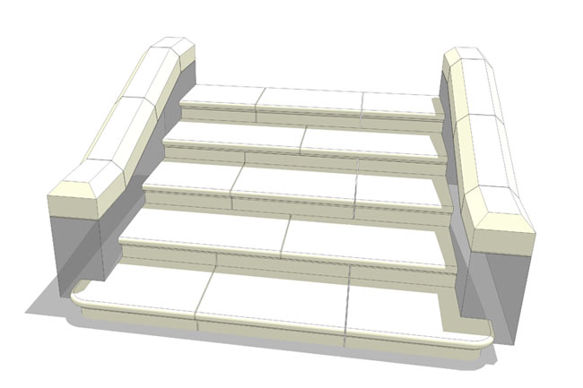
STEP 3
Lesson Objective:
To investigate audience participation within a pantomime
To understand how to include an audience in a pantomime performance.
Muddles, Nursey & Harry complete audience participation .
Nursey leads dialogue

Slide 15
STEP 3
Lesson Objective:
To investigate audience participation within a pantomime
To understand how to include an audience in a pantomime performance.
NURSEY A What?
AUDIENCE A ghost.
NURSEY Did he go that way?(points to the way the ghost went)
AUDIENCE Yes.
NURSEY He didn’t go that way?(points to the way the ghost didn’t go)
AUDIENCE No
NURSEY So he definitely went that way?(points to the way the ghost went)
AUDIENCE Yes.
NURSEY Well. We’ll go and have a look then.

Slide 16

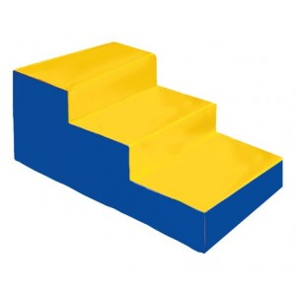
STEP 4
Lesson Objective:
To investigate audience participation within a pantomime
To understand how to include an audience in a pantomime performance.
Muddles, Nursey & Harry do panto walk looking for the ghost.

Slide 17
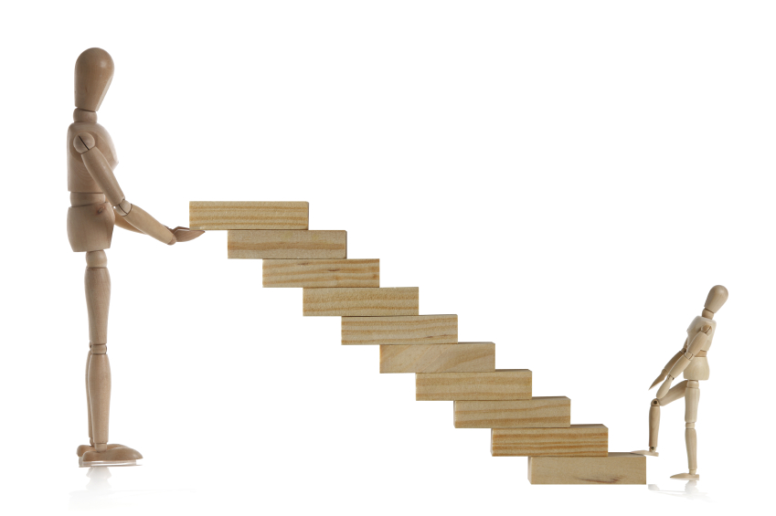
STEP 5
Lesson Objective:
To investigate audience participation within a pantomime
To understand how to include an audience in a pantomime performance.
Muddles, Nursey & Harry complete audience participation.
Nursey leads dialogue

Slide 18
STEP 5
Lesson Objective:
To investigate audience participation within a pantomime
To understand how to include an audience in a pantomime performance.
NURSEY There was nothing there!
AUDIENCE Oh yes there was.
NURSEY/HARRY/MUDDLES Oh no there wasn’t!
AUDIENCE Oh yes there was.
NURSEY Was there?
AUDIENCE Yes.
NURSEY Well, we’ll have to sing it again then won’t we!

Slide 19
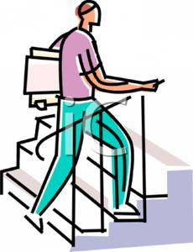
STEP 6
Lesson Objective:
To investigate audience participation within a pantomime
To understand how to include an audience in a pantomime performance.
Repeat Ghostbusters song but this time the ghost comes on from other side and scares off HARRY.

Slide 20
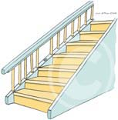
STEP 7
Lesson Objective:
To investigate audience participation within a pantomime
To understand how to include an audience in a pantomime performance.
NURSEY
Where did harry go boys and girls?
AUDIENCE
The ghost took him.
Repeat Steps 3, 4, 5

Slide 21

STEP 8
Lesson Objective:
To investigate audience participation within a pantomime
To understand how to include an audience in a pantomime performance.
Repeat Ghostbusters song but this time the ghost comes on from other side and scares off MUDDLES.

Slide 22
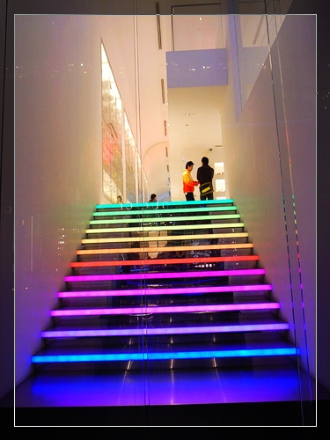
STEP 9
Lesson Objective:
To investigate audience participation within a pantomime
To understand how to include an audience in a pantomime performance.
NURSEY
Where did Muddles go boys and girls?
AUDIENCE
The ghost took him.
Repeat Steps 3, 4, 5

Slide 23
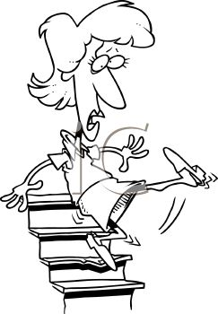
STEP 10
Lesson Objective:
To investigate audience participation within a pantomime
To understand how to include an audience in a pantomime performance.
Repeat Ghostbusters song but this time the ghost comes on from other side and sings with NURSEY

Slide 24
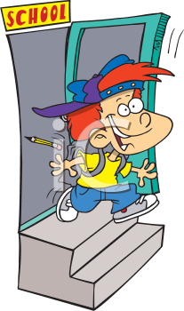
STEP 11
Lesson Objective:
To investigate audience participation within a pantomime
To understand how to include an audience in a pantomime performance.
Nursey talks to audience before seeing ghost. Ghost screams and runs off.

Slide 25
STEP 11
Lesson Objective:
To investigate audience participation within a pantomime
To understand how to include an audience in a pantomime performance.
NURSEY A What?
AUDIENCE A ghost.
NURSEY Where?(not seeing ghost)
AUDIENCE Right there.
NURSEY Right next to me?(points to ghost without looking)
AUDIENCE Yes
NURSEY I better have a look then?(slowly turns to look at ghost)
GHOST Loud scream and then runs off.
NURSEY Blooming Cheek.

Slide 26
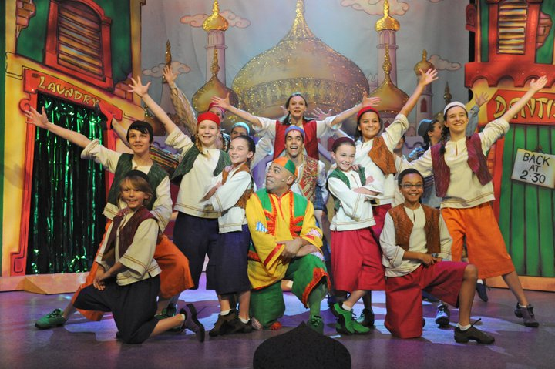
Last Practice
Lesson Objective:
To investigate audience participation within a pantomime
To understand how to include an audience in a pantomime performance.
Last chance to practice…
Work hard and you could show to the class.

Slide 27
SOUND EFFECTS
Lesson Objective:
To investigate audience participation within a pantomime
To understand how to include an audience in a pantomime performance.
GHOSTBUSTERS
PANTO WALK

Slide 28
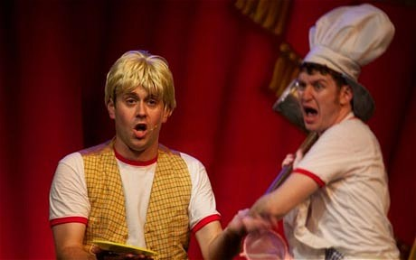
SPOTLIGHT
Lesson Objective:
To investigate audience participation within a pantomime
To understand how to include an audience in a pantomime performance.
Let’s spotlight your work
REMEMBER…
What Went Well
Even Better If?

Slide 29
WHAT DID YOU ACHIEVE TODAY?
Lesson Objective:
To investigate audience participation within a pantomime
To understand how to include an audience in a pantomime performance.
Summing up:
What have you learnt today?
What level have you achieve and how/ why?
What do you need to do to meet your target grade?
Get into a pair.
Share your knowledge and ideas with your partner

